Slide 1



Data Analysis for Social Buzz
By Salman Bareesh
Notes:
30.09.2022
1

Slide 2



Today's agenda
Project recap
Problem
The Analytics team
Process
Insights
Summary
Notes:
30.09.2022
2

Slide 3

Social Buzz is a Social median & Content creation company established in 2008. They create trending content for their customers using large data. Accenture have to run 3 months projects on
Project Recap
An audit of their big data practice
Recommendations for a successful IPO
An analysis of their content categories
Notes:
30.09.2022
3

Slide 4


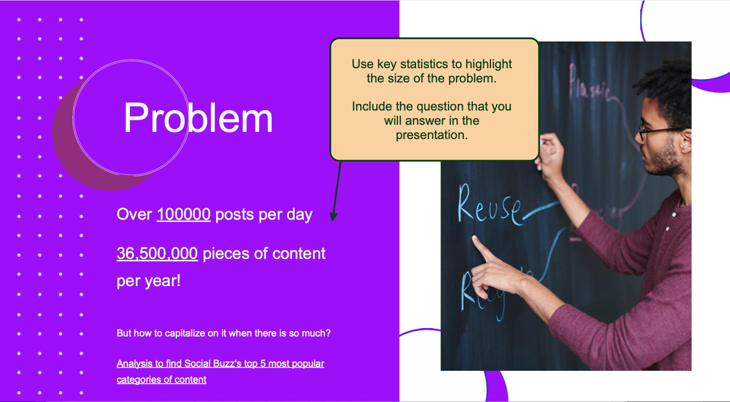
Problem
Notes:
30.09.2022
4

Slide 5
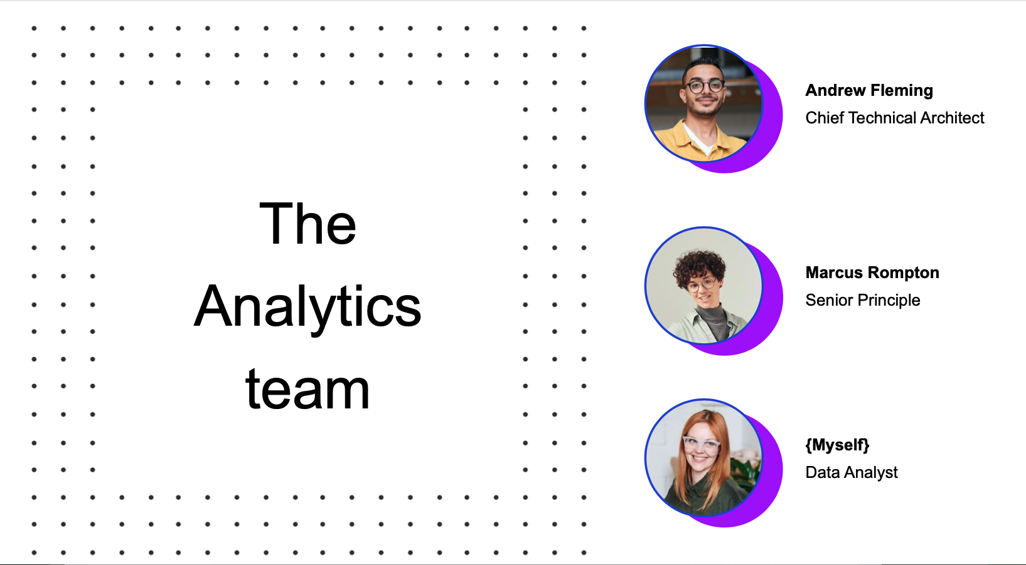




The Analytics team
Salman Bareesh
Notes:
30.09.2022
5

Slide 6

Data Understanding
Process
1
Data Cleaning
2
Data Modeling
3
4
Data Analysis
5
Insights
Notes:
30.09.2022
6

Slide 7
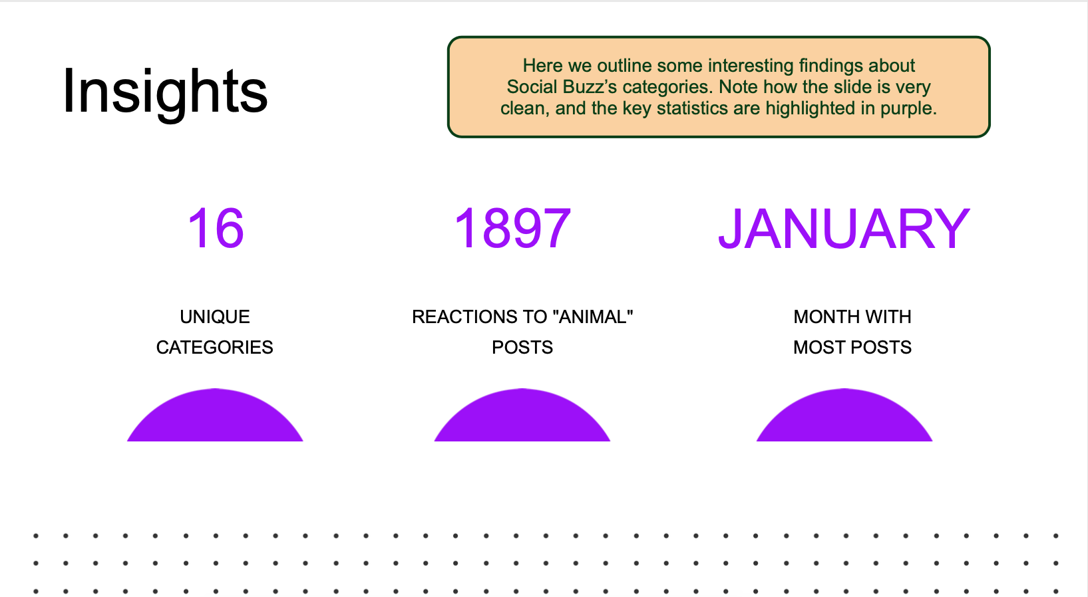

Insights
Notes:
30.09.2022
7

Slide 8
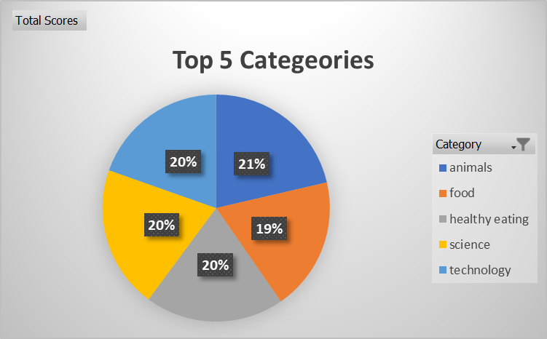

Notes:
30.09.2022
8

Slide 9
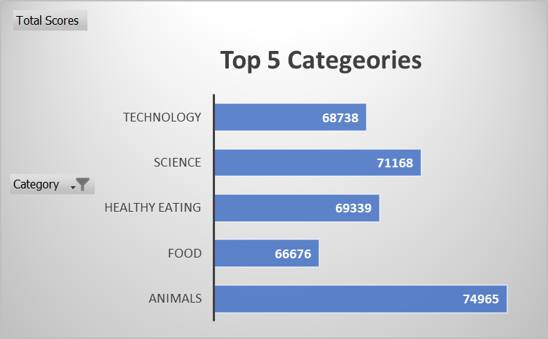
Notes:
30.09.2022
9

Slide 10
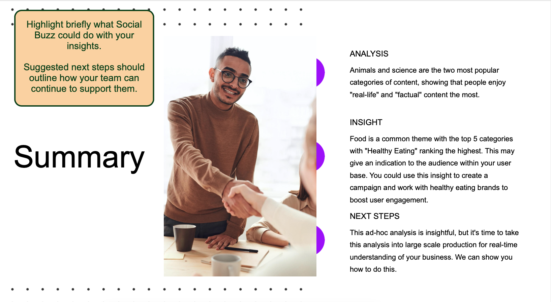


Summary
Notes:
30.09.2022
10

Slide 11

Thank you!
Notes:
30.09.2022
11

